Slide 1
Stubble Management
Team members
AKSHIT DHRUV (18BCP003)
APURVA LALCHETA (18BCP009)
TEAM LEADER
APURVA LALCHETA

Slide 2
Project Details
Our project is mostly focused on the stubble management.
Nowadays farmers burnt their stubble after they have segregated the grains from the crops due to this reason the pollution of air is increasing day by day.
We provide a medium to sell their stubble to industry which need it most.
Due to this medium it is the win – win situation for both the side farmers and industry. Farmer will get some money for their waste and industry will get the raw material which they want to make their product.

Slide 3
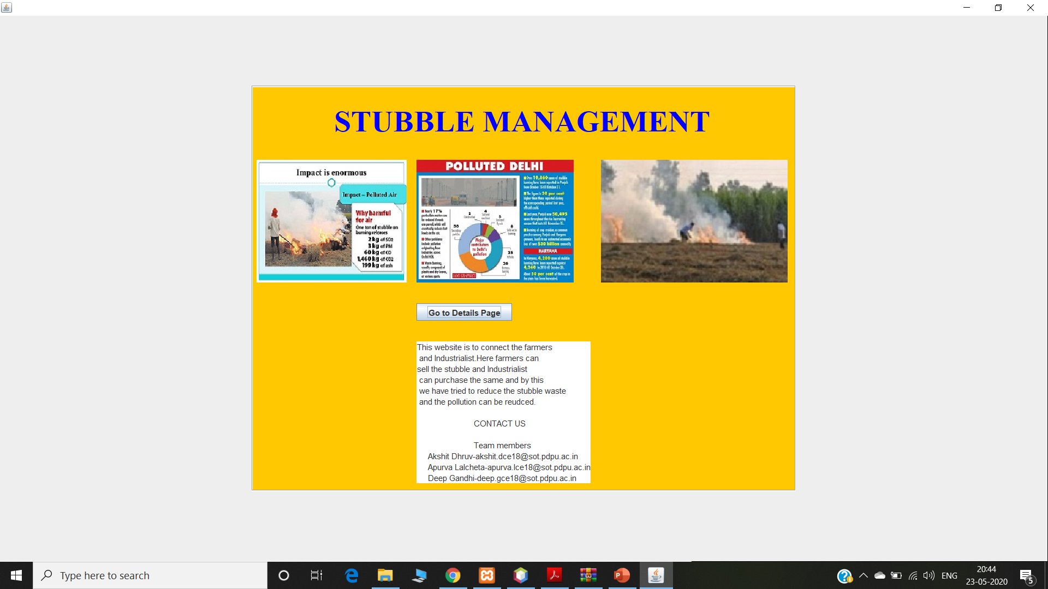
Starting page
On this page we have given the information of our main service and the details so that you can contact us.

Slide 4
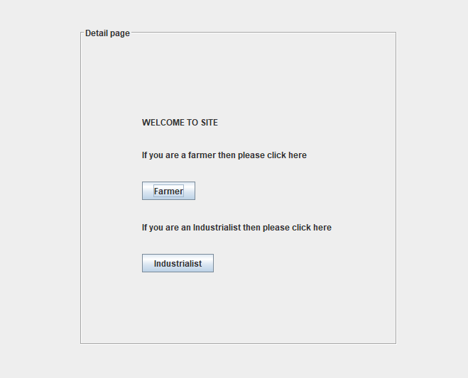
Detail page
On this page we have given you the option that where you want to go by two options.
1.Click farmer if you are farmer.
2.Click industrialist if you are industrialist.

Slide 5
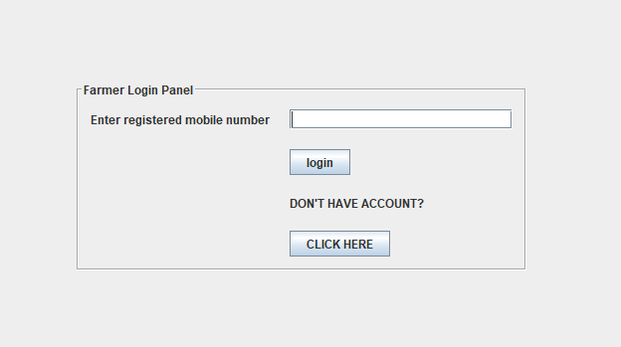
Farmer login
If you select as farmer on the detail page then you will come to this page.
If you have an account you can directly go to the selling page and if you don’t have an account you can create one by clicking on the click here.

Slide 6
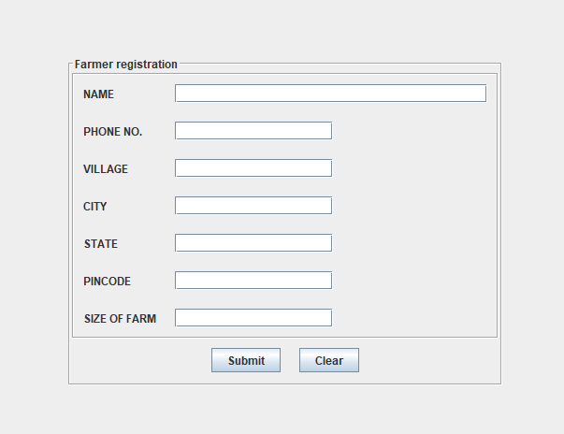
Farmer Register
If you don’t have an account this page will help you to make one account as a farmer.

Slide 7
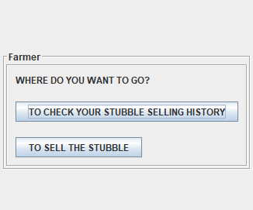
Farmer Intermediate
If you already have an account then you will come to this page with two options.
1.If you click on TO CHECK YOUR STUBBLE SELLING HISTORY you can see your history.
2. If you click on TO SELL THE STUBBLE you can go to sell your stubble.

Slide 8
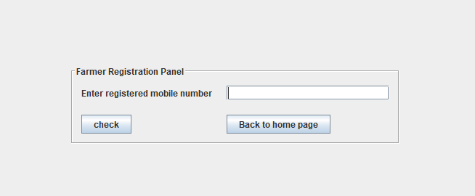
Farmer History
After entering your registered number you can see your history and if you click on the Back to home Page it will lead you to the starting page.

Slide 9
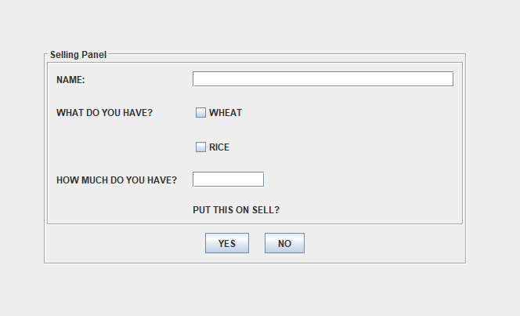
Farmer Sell page
This page will allow you farmer to sell their stubble.
If you select YES as the option your stubble will be out online successfully and if you click on NO you will go back to the farmer intermediate page.

Slide 10
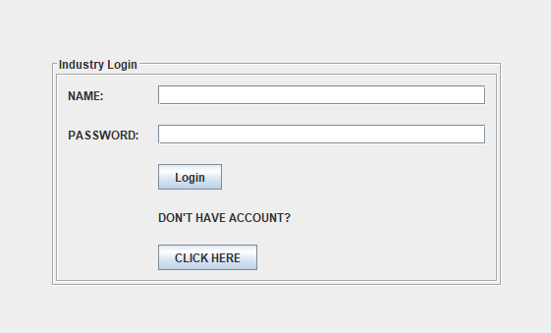
Industry Login
If you select on the industrialist on the details page you will be here.
You can enter your details or you can make a new account as the industrialist if you don’t have an account.

Slide 11
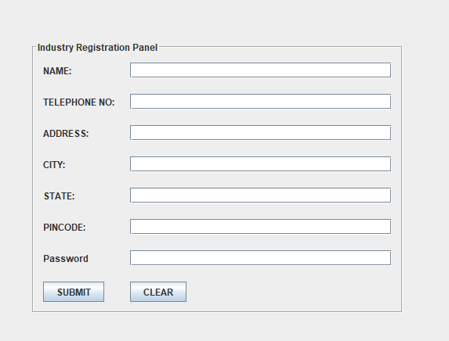
Industry Register
If you don’t have an account this page will help you to make one account as a Industrialist.

Slide 12
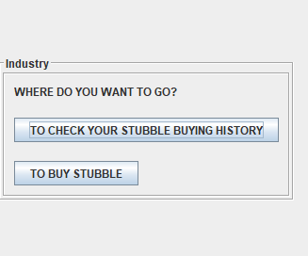
Industry Intermediate
If you already have an account then you will come to this page with two options.
1.If you click on TO CHECK YOUR STUBBLE BRING HISTORY you can see your history.
2. If you click on TO BUY STUBBLE you can go to sell your stubble.

Slide 13
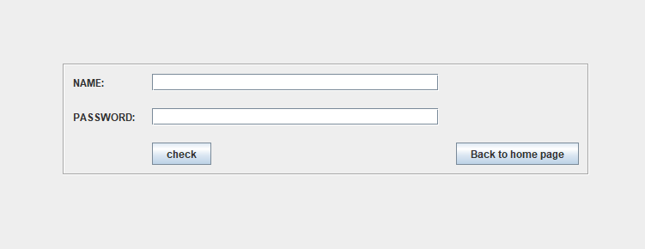
Industry History
After entering your registered number you can see your history and if you click on the Back to home Page it will lead you to the starting page.

Slide 14
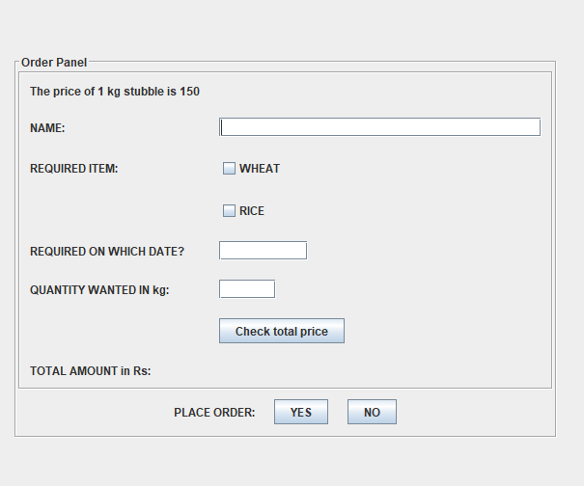
Industry Buy page
This page will allow you industrialist to buy stubble.
If you select YES as the option your request will be out online successfully and if you click on NO you will go back to the Industry intermediate page.

Slide 15
Exception Handled and the section which handles it.
There is basically one exception which is handled in the project which is SQLException.
This exception is used at the placed where we have connected the database. We have used this try and catch block in the farmerlogin and industry login file.

Slide 16
Components we have used in the project
GridBagLayout
JPanel
JLabel
JButton
JTextArea
JOptionPane
Result Set
JScrollPane
JTable
Prepared Statement
Default Table Model
Driver Manager

Slide 17
Application of the project
This app provides medium between farmer and the industry who uses stubble as their raw material.
The industry and the farmer can see their past buying and selling of stubble respectively.
Due to this history feature farmers can see how much money they have made by just selling their waste.
This whole project will be run by the government so it will be transparent.

Slide 18
THANK YOU

